Slide 1
SERVE INTENSIVE
A Brain-Based Approach to Working with Victims of Complex Trauma And CSEC
Bonnie L. Martin, LPC

Slide 4
Diagnostic Presentation
ADHD
Bipolar
Borderline Personality Disorder
Conduct Disorder
Generalized Anxiety Disorder
Attachment Disorder
Enuresis, Encopresis
Schizophrenia
Major Depressive Episode/Dysthymia
Oppositional Defiant Disorder
Dissociative Identity Disorder
Eating Disorder
Substance Abuse Disorder
**** PTSD/Acute Stress Disorder****

Slide 5
Definition of Complex PTSD
Includes the core symptoms of PTSD (re- experiencing, avoidance/numbing, and hyper-arousal)
In conjunction with a range of
disturbances in self-regulatory capacities grouped into five broad domains:
(a) emotion regulation difficulties,
(b) disturbances in relational capacities,
(c) alterations in attention and consciousness (e.g., dissociation),
(d) adversely affected belief systems, and
(e) somatic distress or disorganization.
ISTSS Expert Consensus Treatment Guidelines for Complex PTSD in Adults
November 2012

Slide 6
Stress and the Brain
Prefrontal Cortex:
reasoning, judgment, higher level thinking, executive functioning
Thalamus
Amygdala
to
ANS
Fear/Stress
(in the brain stem)
_ _ _ _ _ _ _ _ _ _ _ _ _ _ _ _ _ _ _ _ _ _ _ _
sympathetic
parasympathetic

Slide 7
Limbic Brain Dominance
Childhood/Adolescence
Limbic
System
Trauma
Addiction

Slide 9
SAFEty First
Stick to what you know
Ask questions
Focus on strengths
Embrace anger and grief

Slide 10
NONCONFRONTAL APPROACH:
MINIMIZE STRESS RESPONSE REACTION
Seating
Eye contact
Eye level
Scan for signs
Stop (up to 20-30 minutes)

Slide 11
Notes:
Hug me dad

Slide 12
HOLD SPACE http://upliftconnect.com/hold-space/
….It means that we are willing to walk alongside another person in whatever journey they’re on without judging them, making them feel inadequate, trying to fix them, or trying to impact the outcome. When we hold space for other people, we open our hearts, offer unconditional support, and let go of judgement and control.

Slide 13
1. Give people permission to trust their own intuition and wisdom.
2. Give people only as much information as they can handle.
3. Don’t take their power away.
4. Keep your own ego out of it.
5. Make them feel safe enough to fail.
6. Give guidance and help with humility and thoughtfulness.
7. Create a container for complex emotions, fear, trauma, etc.
8. Allow them to make different decisions and to have different experiences than you would.

Slide 14
Human Behavior The answer to every WHY? The brain wants to…
1. Avoid Pain
2. Experience Pleasure
3. Connect to Others

Slide 15
Stages of Change:
pre-contemplation
contemplation
preparation
action
maintenance
Relapse

Slide 16
SPIRIT OF MI
Express Empathy
Develop Discrepancy
Roll With Resistance
Support Self-Efficacy

Slide 17
Trigger: Manage (avoid, prevent, confront)
Thought: STOP! (distract, disorient)
Craving: 30 minutes (get out/reach out)
Relaspe and Repeat: Learn (without shame/blame)

Slide 18
WHY?
Who?
What?
When?
Where?
How?

Slide 19
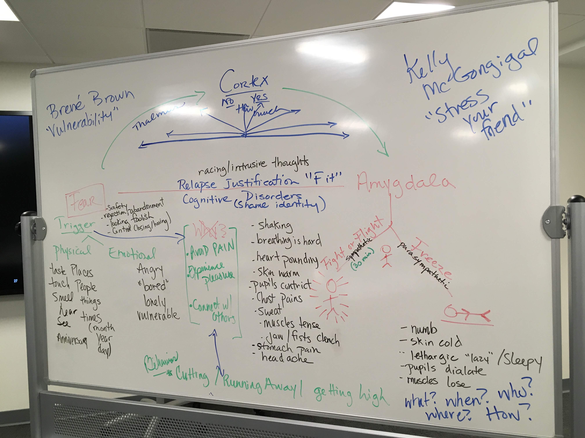

Slide 20
Recovery Stages
Stage 1: Withdrawal
(day 0-15)
Stage 2: Early Abstinence: “Honeymoon”
(day 45-120)
Stage 3: Protracted Abstinence: “the Wall”
(day 120-180)
Stage 4: Adjustment/Resolution
(day 180- )
Matrix Model of Addiction Recovery

Slide 21
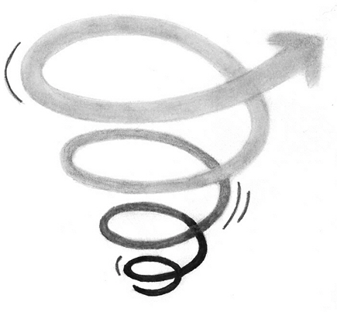
The Upward Spiral Model
This…..
Not This…..

Slide 22
What is a Brain-based Approach?
We operate from a BASE
BRAIN
ATTACHMENT
SYSTEMS
EVIDENCED BASED

Slide 23
B=Brain
Fight/Flight or Freeze
Triggers (emotional/physical)
Limbic activity (risk taking, impulsivity, emotional dysregulation, poor concentration, socialization)
Memory/Time
Behaviors for coping w/somatic symptoms (including substances)
Rule out: TBI, FAS, birth complications, early childhood neglect/abuse

Slide 24
A=ATTACHMENT
Establish healthy boundaries
Identity transference/countertransference
Build Rapport via respect (the spirit of MI)
Honor the power of the Betrayal Bond/Trauma Bond/Survivor guilt
Authenticity/Unconditional positive regard
Foster trust: don’t make promises you can’t keep/no surprises
Conflict is welcome if resolved with out rejection, abandonment and abuse

Slide 25
S=Systems
Work within all systems: education, housing, friends, employment, health, mental health, dental, church, child-care, transportation, social work, financial, legal system.
Build collaborative relationships with other professionals and para professionals (avoid triangulation)
ADVOCATE

Slide 26
E=Evidenced Based
Motivational Interviewing
Storiez Narrative Therapy
Scheduling/Journaling
Seeking Safety
Living in Balance Substance Abuse Program
Acceptance and Commitment Therapy for trauma*
TF_CBT, CBT, DBT*
Matrix Substance Abuse Program (separate women’s)*
Exposure therapy, EMDR, Stress Inoculation Therapy*
BECK Depression (Adult/Youth), BURNS Anxiety, PTSD Inventory

Slide 27
Brain Based Approach
We plant SEEDS for brain health
S= Socialization
E= Education (anything new)
E= Exercise (30+ cardio 5x a week)
D= Diet *hydration
S= Sleep (Surf City App “Sleep Hypnosis”, Journaling, Trazadone, Antihistamine, Protein+whole grain, Chamomile)
Dr. John Arden: The Brain Bible

Slide 28
SERVE
Symptom Normalization
Education about the brain’s stress response and development
Regulation of the body and thoughts
Validation of anger and grief
Empowerment of an integrated self

Slide 29
SERVE model
S= Symptom Normalization: SHARE what you know (normalize!)
Symptoms are normal for abnormal stress.
There is nothing wrong with the them. What happened to them was wrong.
The body and mind adapt to survive. This survival mode can continue after danger is over. (Neurons that fire together wire together)
What helps us survive can be harmful when survival is no longer needed.

Slide 30
Lower brain: Complex Trauma
Black and White thinking
Peer relationships dominate
Emotional and physical dysregulation
Time impairment
Memory impairment
Learning impairment
Disorganized attachment
Absence of a pre-trauma personality
Shame Identity
Risk taking/impulsivity
Impairment in motivation
Addiction and other maladaptive behaviors (drugs/alcohol/drama/anger, cutting)
TRIGGERS

Slide 31
SERVE model cont
E= EDUCATE about the stress response
Educate about stress and the brain
We learn to manage stress from others (shame, mistrust, control)
Perceived stress (a trigger) activates the fear response in the brain
Too much stress over a long time or too much stress too fast can change the way the brain processes stress of any kind
Stress response sets off a reaction of fight/flight OR freeze

Slide 32
Critical Areas of the Brain

Slide 34
SERVE model cont.
R=REGULATE the body and thoughts
Body regulation (ANS): Deep breathing, progressive muscle relaxation, Alternation bilateral stimulation (right/left), grounding, orientating response
Thought regulation: HEALS (Anger), mindfulness, writing, spiritual connection, thought stopping, Apps (surf city hypnosis),
Precise Language Approach (feelings inventory/cognitive distortions)
Positive confirmation bias (Gratitud, Happify App)

Slide 37
ACTIVITIES
For regulating stress
Progressive Muscle Relaxation
Alternating Bilateral stimulation
Tapping
Writing (ugly journal)
“Theratapper”/ EMDR
Orientating Response
lemon, sour candy, hot candy, strong mint, ice
cold shower
Diaphragm breathing (4-7-8)
sips of water
stomach like a balloon
sing while lying down
Grounding
talk about themes unrelated to what is causing the stress (distract)
five senses (5,4,3,2,1)
silly putty/kinetic sand
Arts/crafts/cooking
Calming/Oxytocin
suck on chocolate, hot tea, hot shower, warm bath, candlelight
Essential oils (lavender, mint)
hand on heart, massage, meditation (prayer, etc), music

Slide 38
Progressive Muscle Relaxation
Alternating Bilateral stimulation
Tapping
Writing (ugly journal)
“Theratapper”/ EMDR

Slide 39
Diaphragm breathing (4-7-8 video Dr Weil)
sips of water
stomach like a balloon
sing while lying down
app for phone (CALM, Surf City Hypnosis)

Slide 40
Orientating Response
lemon, sour candy, hot candy, strong mint (taste)
Ice
Essential Oils/candles (strong smell)
Cold shower

Slide 41
Grounding
talk about themes unrelated to what is causing the stress (distract)
five senses (5,4,3,2,1)
silly putty/kinetic sand
art/crafts/cooking

Slide 42
Calming/Oxytocin
suck on chocolate, hot tea, hot shower, warm bath, candlelight
Essential oils (lavender, mint)
Hand on heart
Massage
Meditation/prayer/spiritual practices
Music

Slide 43
Notes:
Fly video

Slide 44
Notes:
Lean on me

Slide 45
SERVE model cont.
V=VALIDATE anger and grief
Allow survivor to think, feel, and speak no matter how unpleasant the thoughts/feelings are to you
Hold Space
Validate injustice, hurt, anger, and loss
Spiral Model: healing from anger and grief is a long, sometimes lifelong, process
Avoid bypass (forgiveness/denial, minimization)

Slide 46
SERVE model cont.
E=EMPOWER: promote resiliency
Acceptance of what has happened without shame
“once”, “sometimes”, “often” (language matters)
Find meaning in suffering
Foster future thinking
Focus on identity beyond the trauma

Slide 47
Focus on Three Rs:
Responsibility
Responsible to not Responsible for
Reconciliation
Reconciling what should not be with what is
Resiliency
Resiliency results from adversity

Slide 48
Sponge vs mirror

